Slide 1
Accelerating Deep Learning with the Biggest Losers
Angela H. Jiang, Daniel L.-K. Wong, Giulio Zhou,
David G. Andersen, Jeffrey Dean, Gregory R. Ganger,
Gauri Joshi, Michael Kaminsky, Michael A. Kozuch,
Zachary C. Lipton, Padmanabhan Pillai
Notes:
"with the biggest losers"!
General: with more intuition and more accessible. Number of specific slides too
Remember your audience: maybe don't know need kath18
Make sure the slides fill the whole screen
it's an interesting qestion. there's a lot of things that dnns apply to. a lot of things like image based . there's been at least one attempt made to be done in language modeling that idn't work but it's not clear why

Slide 2

Deep learning enables emerging applications
Notes:
Over the last decade, deep neural networks have become a fundamental buildling block of applications, including AlphaGo, autonmous vehicles, translation systems and medical imaging

Slide 3
DNN training analyzes many examples
Notes:
However, it’s hard to create these underlying DNNs. The way these models work, is you show them examples of what it's supposed to be predicting. For instance, if you want your DNN to be able to recognize pedastrians, you need to show it millions of examples of different pedestrians over and over and over again. You can imagine, that this takes a lot of time and computing resources.

Slide 4
Selective-Backprop prioritizes informative examples
Notes:
Our technique, SB, carefully selects what examples to prioritize, so that the DNN trains faster and the resulting DNN is more accurate

Slide 5
DNN basics
How to use and train a DNN

Slide 6
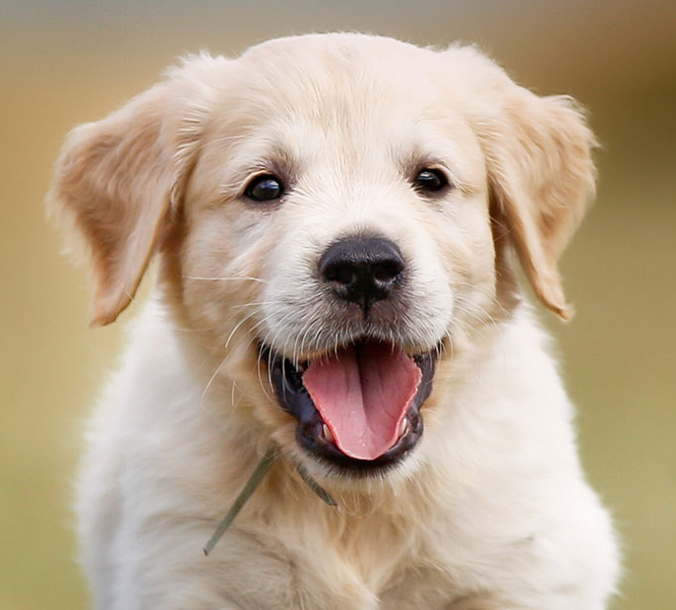
Example task: Image classification
Dog
DNN
Lizard
Goat
Bird
Notes:
Start with higher level: e.g., semantic analysis for instance, image classification, or something more complicated like object detection, segmentation or pose estimation

Slide 7
DNN inference: From image to “Dog”
.6
Dog
.1
Lizard
.2
Goat
.1
Bird
Notes:
Start with higher level: e.g., semantic analysis for instance, image classification, or something more complicated like object detection, segmentation or pose estimation

Slide 8
Training DNNs relies on a labeled dataset
Class: Dog
Class: Bird
Class: Lizard
Class: Dog

Slide 9
DNN training: Determining the weights
Class 1

Slide 10
DNN training: Determining the weights via backpropagation
Class 3
Notes:
Penalize and reward the network via something called backpropagation

Slide 11
DNN training: Determining the weights via backpropagation
Class 2
Notes:
Weights => Parameter

Slide 12
DNN training analyzes an example many times
Epoch 1
Epoch 2
Notes:
Can we avoid doing the backwards pass so often? What if there are examples that are more surprinsing that teach the ntwork more than others?
Backward pass is when the network is learning, so you can learn more from surprising examples
Standard thing is to train on everything. But like anything there's skew. There's some examples that are more useful to train on everything! Spend more time learning from the hard examples because they're harder. Focus on more othe attenton oh ard attnetion, not all the attention
The way we're gonna reduce the backwards pass, by skipping the backwards pass by the thing that's easy
Backwards pass is slow -> cosine similarity
Where are you gonna find the opportunity is to recognize that they're not all qually useful (if all math problems are 2+2, then you don't want to remove all of them) if you're working on flashcards, you start skipping the flashcards
Make this slide into a LOOP. there are many epochs, send all the images through in many epochs, standard training is n epochs so we're going to see N million images. this is where a lot of time is spent. (so you get the iterative feel and how big it is). then you understand why backprops
why do you start over, debugging the model, trying to improve the accuracy. reducing the time from 80 hours!@ to 40 hours is really signficant, otherwise you can't try again. The best you can hope for is a factor of 2. Is it significant, well it is because it's a huge debugging cycle. Less compelling if it's 1 hour
say "for all experiments we focus on image classification"
SMART BUT IGNORANT

Slide 13
DNN training analyzes an example many times
Epoch 250
Notes:
Can we avoid doing the backwards pass so often? What if there are examples that are more surprinsing that teach the ntwork more than others?
Backward pass is when the network is learning, so you can learn more from surprising examples
Standard thing is to train on everything. But like anything there's skew. There's some examples that are more useful to train on everything! Spend more time learning from the hard examples because they're harder. Focus on more othe attenton oh ard attnetion, not all the attention
The way we're gonna reduce the backwards pass, by skipping the backwards pass by the thing that's easy
Backwards pass is slow -> cosine similarity
Where are you gonna find the opportunity is to recognize that they're not all qually useful (if all math problems are 2+2, then you don't want to remove all of them) if you're working on flashcards, you start skipping the flashcards
Make this slide into a LOOP. there are many epochs, send all the images through in many epochs, standard training is n epochs so we're going to see N million images. this is where a lot of time is spent. (so you get the iterative feel and how big it is). then you understand why backprops
why do you start over, debugging the model, trying to improve the accuracy. reducing the time from 80 hours!@ to 40 hours is really signficant, otherwise you can't try again. The best you can hope for is a factor of 2. Is it significant, well it is because it's a huge debugging cycle. Less compelling if it's 1 hour
say "for all experiments we focus on image classification"
SMART BUT IGNORANT

Slide 14
SelectiveBackprop targets slowest part of training
Notes:
Skip the stale SB bars here. And by the way we've come up with some tricks to reduce the green, but i wanted to focus your attention right away, there's. afacotr of 2 potential benefit here to figure out how to reduce the number of backprops. Do the intuition next --> with the pictures in the back, put the identical graphs.
Make the green all the same. Make all of them solid colors. Forward selecting can be light green
it's in hours and it goes to 90. it's a reltiavely simple training task. that's why t his is important
same number of ofrwards and backwards so each bw is twice the amount of time
ADD:
decrease time to error
maximize accuracy you get as a function of the amount of time to train
I'm showing you this result in terms of a runtime!!
"I'm not going to tell you all the details of this...but this is the result of a particular model being trained. Details to come. WHat i want you do know bout it. before we do something it looks like this, after we do something it looks like this

Slide 15
Not all examples are equally useful
Notes:
For example why are each of these being treated equally while the others are treated as unique. What you see happening is that they're becomming easy even if they weren't before becuse they're getting so much attention
the problem isn't just that there are 8 times more of this car than this ostrich. but in addtion, some examples are just easily learned

Slide 16
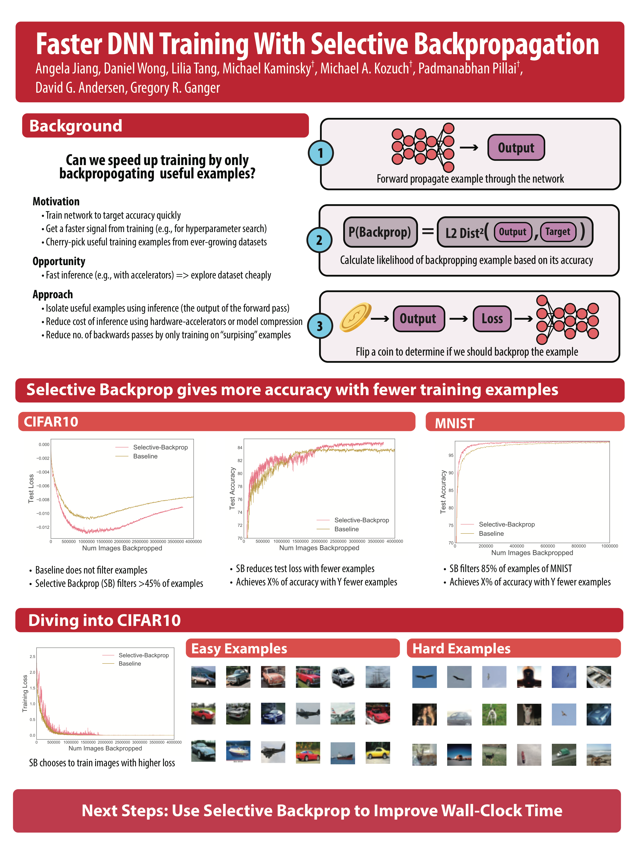
Prioritize examples with high loss
Examples with low loss
Examples with high loss
Notes:
Can use if we make it really clear about how to interpret this graph. Maybe just remove. Shrink it down, by the way we have experimental evidence that suggest this is right. You can come see me at the poster session

Slide 17
Selective Backprop algorithm

Slide 18
DNN training analyzes an example many times
Notes:
Can we avoid doing the backwards pass so often? What if there are examples that are more surprinsing that teach the ntwork more than others?
Backward pass is when the network is learning, so you can learn more from surprising examples
Standard thing is to train on everything. But like anything there's skew. There's some examples that are more useful to train on everything! Spend more time learning from the hard examples because they're harder. Focus on more othe attenton oh ard attnetion, not all the attention
The way we're gonna reduce the backwards pass, by skipping the backwards pass by the thing that's easy
Backwards pass is slow -> cosine similarity
Where are you gonna find the opportunity is to recognize that they're not all qually useful (if all math problems are 2+2, then you don't want to remove all of them) if you're working on flashcards, you start skipping the flashcards
Make this slide into a LOOP. there are many epochs, send all the images through in many epochs, standard training is n epochs so we're going to see N million images. this is where a lot of time is spent. (so you get the iterative feel and how big it is). then you understand why backprops
why do you start over, debugging the model, trying to improve the accuracy. reducing the time from 80 hours!@ to 40 hours is really signficant, otherwise you can't try again. The best you can hope for is a factor of 2. Is it significant, well it is because it's a huge debugging cycle. Less compelling if it's 1 hour
say "for all experiments we focus on image classification"
SMART BUT IGNORANT

Slide 19
Bad idea #1: Deciding with a hard threshold
if loss > threshold: backprop()

Slide 20
Bad idea #2: Deciding probabilistically with absolute loss
P(backprop) = normalize(loss, 0, 1)
Notes:
clamp -> normalize
Maybe talk about the lower bound, we do revisit all the images probabilistically

Slide 21
Good idea: Use relative probabilistic calculation
P(backprop) =
Percentile(loss, recent losses)^{B}
Notes:
clamp -> normalize
Maybe talk about the lower bound, we do revisit all the images probabilistically

Slide 22
Example of probability calculation
CDF(loss) = 0.9
Probability = .96
Loss = 2.3
CDF(loss) =0.9
Notes:
Where the size of the vector corresponds to the number of classes we have
We denote the class the example belongs to, with a 1 at that index
Strength of our belief, normalized to sum up to one
We’re choosing to backprop this thing because we’re currently bad at it. Of course, this may change over the course of training.
Come up with an example -> "So this is the probability we use to flip the coin"
Historical -> Recent losses. Historical losses is not a unit!. The last 1000 are as good as history

Slide 23
Selective-Backprop approach
Forward propagate example
through the network
Calculate usefulness of
backpropping example
based on its accuracy
Decide probabilistically
if we should backprop
Notes:
Be more explicit about the connection between surprisingness and probability that you select it
We come up with this probability so that images that we have the most to learn from are most likely to be backpropagated
Move this back a couple of slides.
"lets focus on this question of deciding what to backprop"
Next slide would then be stale
CARTOON OF THE INNER LOOP AND THE FILTER. Then be like these are the different kinds of filters that we tried
Flip a coin ->

Slide 24
StaleSB reduces forward passes
Forward propagate example
through the network
every n epochs
Calculate usefulness of
backpropping example
based on its accuracy
Decide probabilistically
if we should backprop
Notes:
Be more explicit about the connection between surprisingness and probability that you select it
We come up with this probability so that images that we have the most to learn from are most likely to be backpropagated
Move this back a couple of slides.
"lets focus on this question of deciding what to backprop"
Next slide would then be stale
CARTOON OF THE INNER LOOP AND THE FILTER. Then be like these are the different kinds of filters that we tried
instead of doing a forward pass this time, use the loss from last time. and do that up to n times before the next time

Slide 25
Evaluation of Selective Backprop
Notes:
Two ways to look at this,
decrease time to error
maximize accuracy you get as a function of the amount of time to train

Slide 26
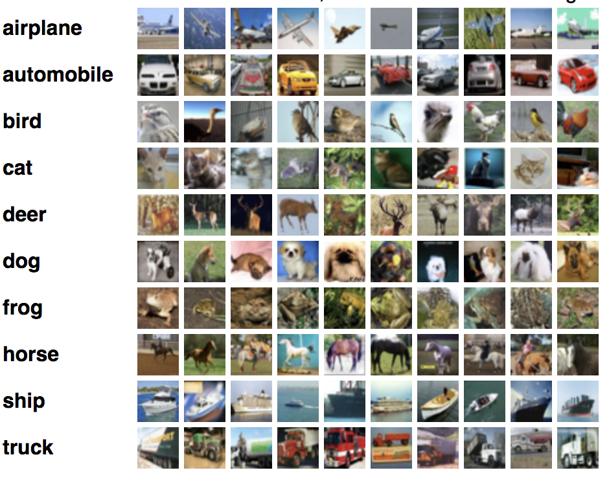
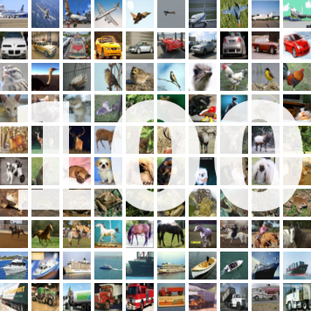
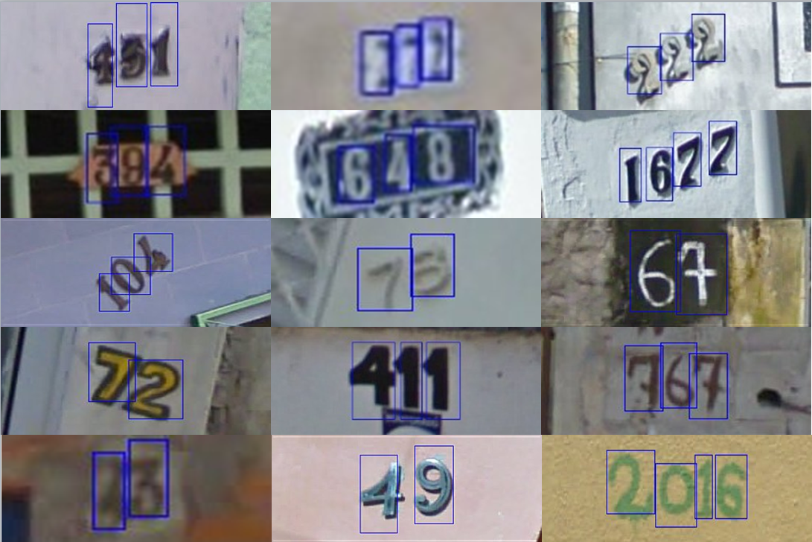
Datasets
CIFAR10
CIFAR100
SVHN
60,000 Training Images
60,000 Training Images
604,388 Training Images
Notes:
Update SVHN # training examples
Swap cifar10 and svhn

Slide 27
Train CIFAR10 to 4.14% (1.4x Traditional’s final error)
SB: 1.5X faster
StaleSB: 2X faster
Notes:
SB: 1.5x
StaleSB: 2.0x
2.96%

Slide 28
Train CIFAR100 to 25.5% (1.4x Traditional’s final error)
SB: 1.2X faster
StaleSB: 1.6X faster
Notes:
SB: 1.2x
StaleSB: 1.6x
18.21%

Slide 29
Train SVHN to 1.72% (1.4x Traditional’s final error)
SB: 3.5X faster
StaleSB: 5X faster
Notes:
SB: 3.5x
StaleSB: 5.0x
1.72%

Slide 30
SB on CIFAR10 targets hard examples
= [0, 1, 0]
3% correct w/ Traditional
29% correct w/ SB
= [0.1, 0.3, 0.6]
= 0.3
Notes:
20th percentile of target confidences for SB is 55%
Put a vertical line here!
Make the graph larger and put labels on the line
put these before it's pareto

Slide 31
✓
Selective-Backprop accelerates training
Reduces time spent in the backwards pass by prioritizing high-loss examples
✓
SelectiveBackprop outperforms static approaches
Trains up to 3.5x faster compared to standard SGD
Trains 1.02-1.8X faster than state-of-the-art importance sampling approach
✓
Stale-SB further accelerates training
Trains on average 26% faster compared to SB
www.github.com/angelajiang/SelectiveBackprop

Slide 32
Compared approaches
Traditional
Classic SGD with no filtering
Katharopoulos18
State of the art importance sampling approach
Random
Random sampling approach
Selective-Backprop (Us)
Notes:
In the real world, we don't know what accuracy we can get to, but we may have a fixed amout of time. Most of the time you'll do better this way. super optimized, run forever kind of things to get the best state of the art accuracy. A lot of times you don't know what the accuracy's gonna be. You're gonna care about it a little less
Remove this whole slide

Slide 33
SVHN
Given 40 hours to train,
Stale-SB provides lowest error
Notes:
CIFAR10: 72%
SVHN: 80%

Slide 34
Most Pareto optimal points are SB or StaleSB
CIFAR10
CIFAR100
Given unlimited time to train,
Traditional provides lowest error
Notes:
CIFAR10: 72%
SVHN: 80%

Slide 35
SB is robust to modest amounts of error
0.1% Randomized
10% Randomized
20% Randomized
Notes:
1.4048, 0.360544 = 74.3% fewer backward passes
55% more forwards passes
move the labels ahead
Next move: SelectiveAugment
The studff i was just taling about. imagein that you have a bunch of things that you do to imagines before you pass them trhough the n ewtork, for isntance rotating them and cropping

